Slide 1
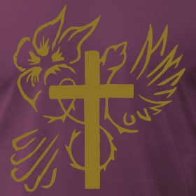
Luke 10:17-24
New International Version (NIV)
²¹ At that time Jesus, full of joy through the Holy Spirit, said, “I praise you, Father, Lord of heaven and earth, because you have hidden these things from the wise and learned, and revealed them to little children. Yes, Father, for this is what you were pleased to do. ²² “All things have been committed to me by my Father. No one knows who the Son is except the Father, and no one knows who the Father is except the Son and those to whom the Son chooses to reveal him.”
²³ Then he turned to his disciples and said privately, “Blessed are the eyes that see what you see. ²⁴For I tell you that many prophets and kings wanted to see what you see but did not see it, and to hear what you hear but did not hear it.”
¹⁷ The seventy-two returned with joy and said, “Lord, even the demons submit to us in your name.”
¹⁸ He replied, “I saw Satan fall like lightning from heaven. ¹⁹ I have given you authority to trample on snakes and scorpions and to overcome all the power of the enemy; nothing will harm you. ²⁰However, do not rejoice that the spirits submit to you, but rejoice that your names are written in heaven.”

