Slide 1
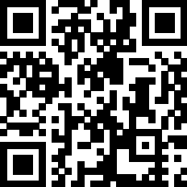
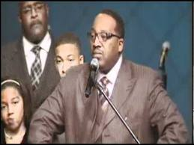
.Minister Ev’s
n
n
n
n
n
n
Y
.Song of the day.
4
Marvin Sapp Let go, Let God
“Let Go and let god”

